Slide 1

How to make data driven decisions to support philanthropic investments and volunteerism
Jennifer Gibbs, Associate Director, Corporate Impact, KPMG US
Nicholas Minar, Ph.D. Director of Research and Reporting, NAF

Slide 2
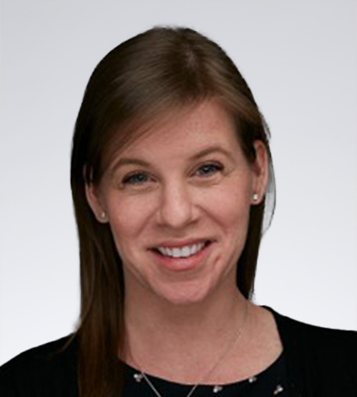
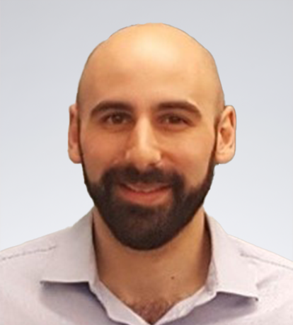
Introduction
Jennifer Gibbs,
Associate Director, Corporate Impact, KPMG
Nicholas Minar, Ph.D.
Director of Research and Reporting, NAF

Slide 3
Measurement Journey
Advanced
Evolving strategy
Moving toward impact
        (i.e. measurable social change)
Using data to make strategic program decisions
Intermediate
Developing strategy
Combo outputs & outcomes
        (i.e. behavior changes, and program sentiments)
Methodology for measurement, not used for decision making
New to Measurement
Established focus areas
Measuring outputs only
        (i.e. number of volunteer hours, $ donated)
Little to no methodology for
data-based decision making

Slide 4
Objective for Session
Objective for Session
Develop a more focused approach to measurement
How to evaluate community need
How to improve your decision-making strategy

Slide 5
The importance of measurement
The importance of measurement
01
Informs strategy
02
Creates the ability to track progress and tell a cohesive story
03
Improves delivery and resource allocation
04
Forced to make difficult program decisions (funding and volunteering)

Slide 6
Measurement Framework
Measurement Framework
Implementation
of a
strategic plan
Focus areas
Desired results
Programs and investments
Vision
statement
What’s
your strategy?
Where are
you investing?
What impact are you hoping to make?
What are you supporting?
What do you hope to achieve?

Slide 7
Sample: Measurement Framework
Sample: Measurement Framework
To support communities and individuals to reach their full potential through educational opportunities and healthcare initiatives for underserved populations. We collaborate to create high-impact initiatives and build resilient communities that benefit all.
Transform our communities through exceptional education and healthcare
Strategy
Approach
Desired results
Program types
Impact
Provide
impactful learning experiences
Help students achieve academic advancements
Literacy programs
Academic support
Mentorship opportunities
Foster
equitable access to healthcare services
Improve access to healthcare services
Awareness programs
Preventative services
Community health centers
How we support:
Grants
Strategic collaborations
Employee volunteering

Slide 8
Examples of metrics
Help students achieve academic advancements
Improve access to healthcare services
Outputs
Number of students reached
$ amount donated
Number of beneficiaries reached
$ amount donated
Outcomes
% of students that have a positive change in attitude
% of students that had improved academic performance and literacy rates
% of beneficiaries who changed their behavior after receiving services
% of organizations that expanded healthcare services
Impact
High school graduation rates
College acceptance rates
Improved health outcomes in the community

Slide 9
Data based decision making
After organization has been vetted
Q1
Is the program aligned with the company's philanthropic focus areas?
Consider whether there are any compelling reasons to deviate from the focus areas.
No
Yes
Consider whether this is a new organization or program and may need support to measure impact or if the program achieves another desired result. If they have a compelling plan for impact, you may still consider them.
Q2
Does the program’s potential impact align with your desired results?
No
Yes
Q3
  Consider whether the organization’s measurement rigor/methodology poses a risk to their ability to deliver impact. If so, what support could be offered to the organization to help them advance in this area.
Does the program have a strong measurement methodology?
No
Yes
Q4
Does this program meet the most pressing needs of the communities
we serve?
No
  Consider if there are other organizations that better align
Yes
Q5
Does the program have a specific target community or population you’re
hoping to impact?
No
  Consider whether the lack of a clear plan impacts their ability to deliver impact.
Yes
  Consider responses to previous questions and determine how to move forward with the program/ organizations

Slide 10
Data based decision making
After organization has been vetted
Q1
Is the program aligned with the company's philanthropic focus areas?
Consider whether there are any compelling reasons to deviate from the focus areas.
No
Yes
Consider whether this is a new organization or program and may need support to measure impact or if the program achieves another desired result. If they have a compelling plan for impact, you may still consider them.
Q2
Does the program’s potential impact align with your desired results?
No
Yes
Q3
  Consider whether the organization’s measurement rigor/methodology poses a risk to their ability to deliver impact. If so, what support could be offered to the organization to help them advance in this area.
Does the program have a strong measurement methodology?
No
Yes
Q4
Does this program meet the most pressing needs of the communities
we serve?
No
  Consider if there are other organizations that better align
Yes
Q5
Does the program have a specific target community or population you’re
hoping to impact?
No
  Consider whether the lack of a clear plan impacts their ability to deliver impact.
Yes
  Consider responses to previous questions and determine how to move forward with the program/ organizations

Slide 11
Our World’s Expanding Data Ecosystem
Our World’s Expanding Data Ecosystem
Q4
Does this program meet the most pressing needs of the communities we serve?
Q5
Does the program have a specific target community or population you’re
hoping to impact?
As of 2021, estimated download time ~ 181 million years
The amount of data available from 2010-2020 increased by 5000%
An estimated 80-90% of the data on the internet is unstructured

Slide 12
The Open Data Index for Schools (ODIS)
U.S. Census Bureau
ODIS Domain | Indicator Variable | Data Source
Economic | Unemployment | Bureau of Labor Statistics
 | Poverty | U.S. Census Bureau
 | Access to broadband internet | U.S. Census Bureau
 | Single-parent household | County Health Rankings
Education | Education less than high school | U.S. Census Bureau
 | Education 2 years of college or more | U.S. Census Bureau
 | Linguistic isolation | U.S. Census Bureau
Health | Access to healthcare | U.S. Census Bureau
 | Infant mortality rate | County Health Rankings
 | SNAP recipients | County Health Rankings
 | Low birth weight | County Health Rankings
 | Lead exposure risk | City Health Dashboard
Housing | Housing-vacancy rate | U.S. Census Bureau
 | Housing affordability | U.S. Census Bureau
 | Park access | City Health Dashboard
Crime | Violent Crime | County Health Rankings
 | Incarceration rate | Vera Institute of Justice
Bureau of Labor Statistics
County Health Rankings

Slide 13
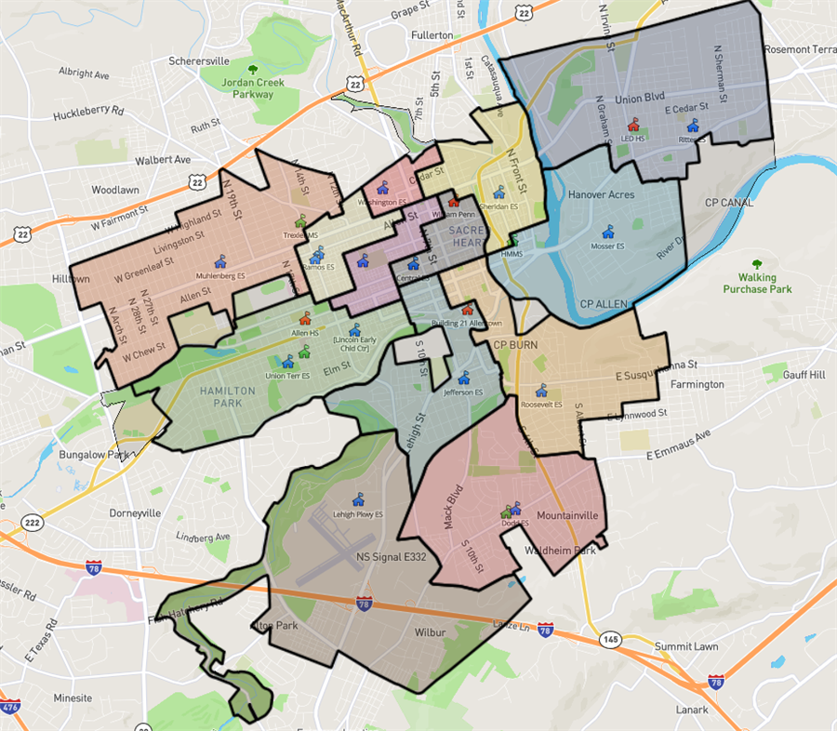
The Open Data Index for Schools (ODIS)
01
Opportunity Index
Community Well-Being Index
Community Opportunity Map
02
03
ODIS Domain | Indicator Variable | Data Source
Economic | Unemployment | Bureau of Labor Statistics
 | Poverty | U.S. Census Bureau
 | Access to broadband internet | U.S. Census Bureau
 | Single-parent household | County Health Rankings
Education | Education less than high school | U.S. Census Bureau
 | Education 2 years of college or more | U.S. Census Bureau
 | Linguistic isolation | U.S. Census Bureau
Health | Access to healthcare | U.S. Census Bureau
 | Infant mortality rate | County Health Rankings
 | SNAP recipients | County Health Rankings
 | Low birth weight | County Health Rankings
 | Lead exposure risk | City Health Dashboard
Housing | Housing-vacancy rate | U.S. Census Bureau
 | Housing affordability | U.S. Census Bureau
 | Park access | City Health Dashboard
Crime | Violent Crime | County Health Rankings
 | Incarceration rate | Vera Institute of Justice

Slide 14

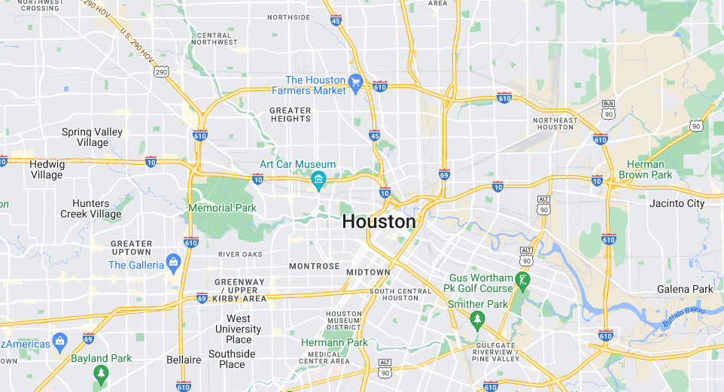
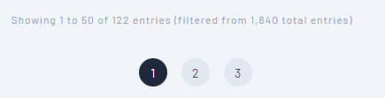
Let’s Walk Through A Use Case
Examples of metrics
https://ash.naf.org/public/odis
State -> Texas
County -> Harris County (Not Houston County)
City ->Houston
City of Houston, Texas = 122 unique 9-12th grade
Public high school communities.

Slide 15

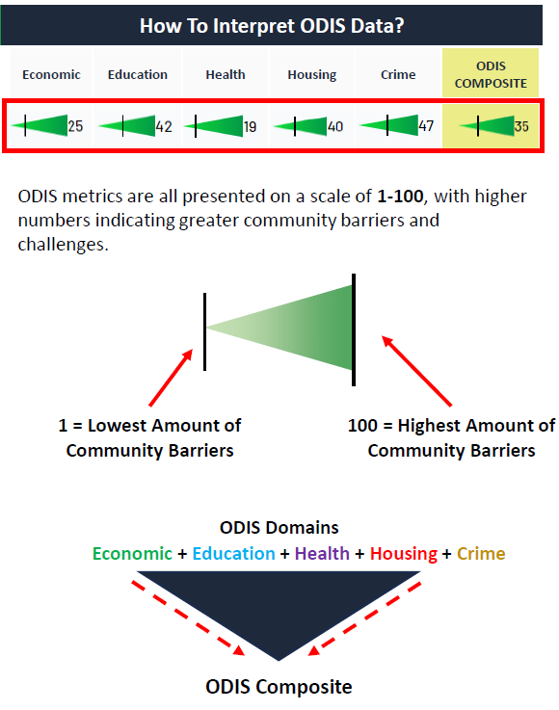
Interpreting ODIS

Slide 16
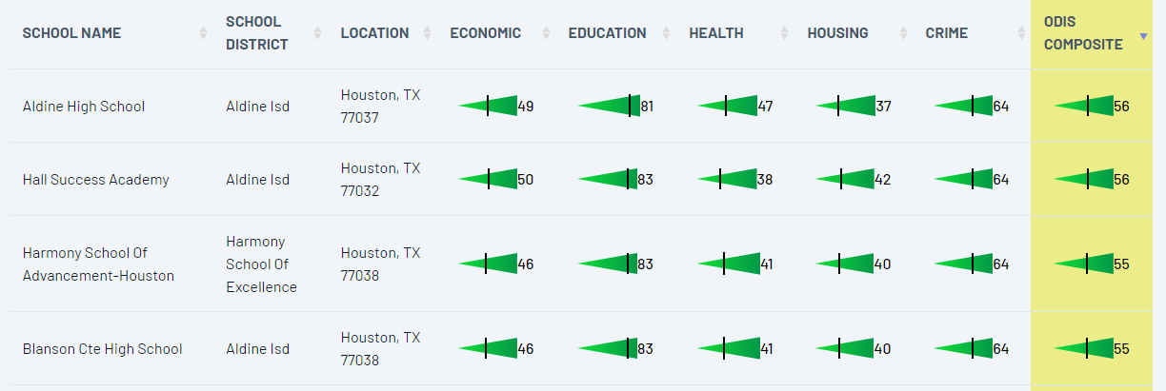
Houston, TX

Slide 17
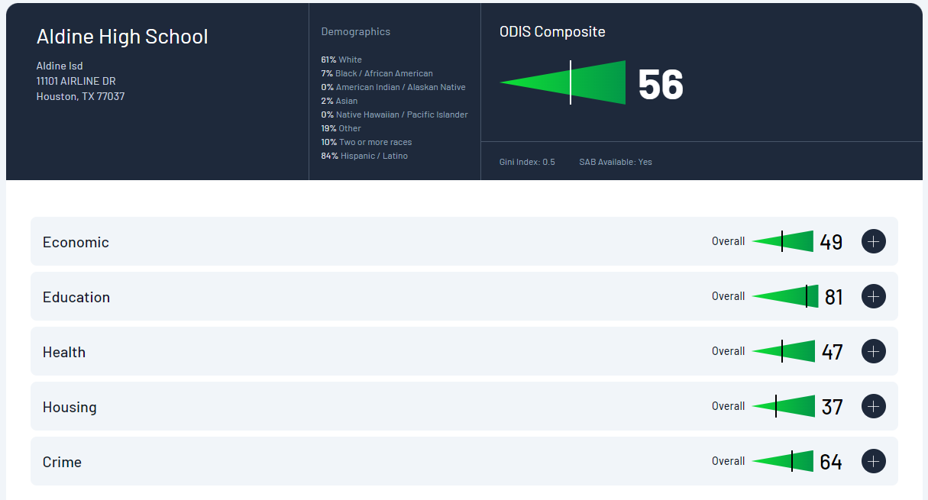
Aldine High School Community

Slide 18
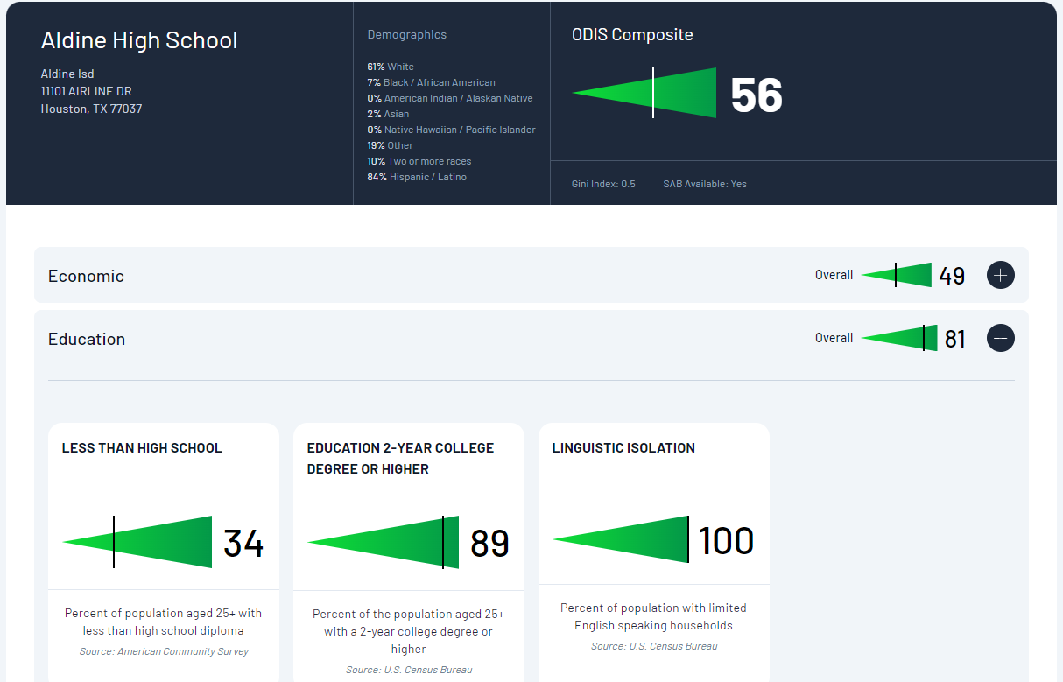
Aldine High School Community

Slide 19
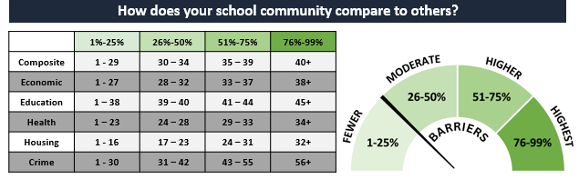
Comparing to National Data

Slide 20
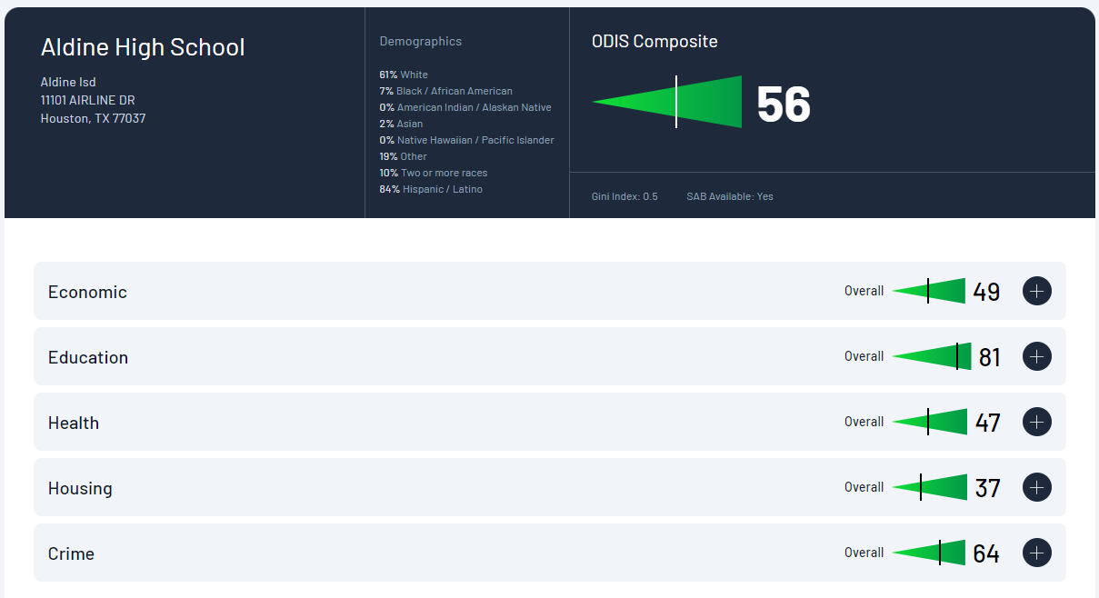
Comparing to National Data

Slide 21
Comparing to National Data
Education’s
Exact percentile = 98%

Slide 22
Example Use Case – HealthRise Foundation
Organization:
HealthRise Foundation
Mission:
Strive to empower high school students, especially BIPOC students of color in rural communities, through health education and resources that foster access to healthcare, improve health literacy, and form positive lifelong habits.
Audiences:
Students, Educators, Community Health Organizations – Focus on BIPOC communities of color
Grant Proposal 1
Grant Proposal 2

Slide 23


Example Use Case – HealthRise Foundation
Grant Proposal 1
Grant Proposal 2
Goal: To establish a youth health literacy program for students that facilitates regular access to healthcare.
Goal: To establish a ride-share program pairing school students with community members aged 65+ to overcome transportation barriers related to access to healthcare.
Location: Cheyenne Wells, CO
Free/Reduced Price Lunch: 100%
School Type: Rural
Location: Riverdale, CA
Free/Reduced Price Lunch: 90%
School Type: Rural
Q1
Is the program aligned with the company’s
philanthropic focus areas?
Q4
Does this program meet the most pressing needs of
the communities we serve?
Q2
Does the program’s potential impact align with your desired results?
Q5
Does the program have a specific target community or
population you’re hoping to impact?
Q3
Does the program have a strong measurement
methodology?

Slide 24
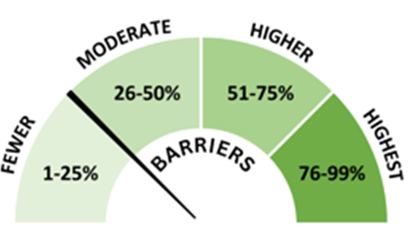
Example Use Case – HealthRise Foundation
Grant Proposal 1
Grant Proposal 2
Goal: To establish a youth health literacy program for students that facilitates regular access to healthcare.
Goal: To establish a ride-share program pairing school students with community members aged 65+ to overcome transportation barriers related to access to healthcare.
Demographic Makeup: 87% White, 6% “other” and 6% two or more races; 17% identifying as Hispanic/Latino
Overall ODIS Composite: 26
Health ODIS: 24
Access to Healthcare: 14
Demographic Makeup:49% White, 37% “Other”, 11% Two or more races; 79% Hispanic/Latino
Overall ODIS Composite: 57
Health ODIS: 45
Access to Healthcare: 6
Q4
Does this program meet the most pressing needs of
the communities we serve?
Q5
Does the program have a specific target community
or population you’re hoping to impact?

Slide 25
Data Decision Tree Use Case – YOUR Organization
Organization:
Your Organization
Mission:
Your organization’s mission
Audiences:
Who does your organization serve?
Q1
Is the program aligned with the company's philanthropic focus areas?
Q2
Does the program’s potential impact align with your desired results?
Q3
Does the program have a strong measurement methodology?
Q4
Does this program meet the most pressing needs of the communities we serve?
Q5
Does the program have a specific target community or population you’re hoping to impact?

Slide 26
CodeInclusive
Organization:
CodeInclusive
Mission:
Strives to address the widening skills and degree attainment gap for software engineers by working directly with high schools to get students interested in computer programming and coding.
Audiences:
Students (especially BIPOC), Industry Computer Programmers
Measurement Strategy:
Track the number of student/industry engagements and also how many program participants have a reliable industry contact in computer science.
The Ask:
Interested in $25,000 of funding or 20 volunteers to work with them at a school near your offices

Slide 27


CodeInclusive
Q1
Is the program aligned with the company's philanthropic focus areas?
Q2
Does the program’s potential impact align with your desired results?
Access to broadband
internet
Q3
Does the program have a strong measurement methodology?
Q4
Does this program meet the most pressing needs of the communities
we serve?
Q5
Does the program have a specific target community or population you’re
hoping to impact?
Two-year college
degrees or higher
65% Black/African American
20% White
75% Hispanic/Latino

Slide 28
Key Takeaways
01
The tools to develop a more focused approach to measurement
02
Understand how to assess community need
03
How to make data-based decisions

Slide 29
Q&A

Slide 30
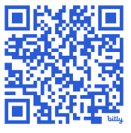
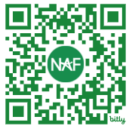
Thank You!
Jennifer Gibbs,
Associate Director, Corporate Impact, KPMG
Nicholas Minar,
Ph.D. Director of Research and Reporting

